Slide 1
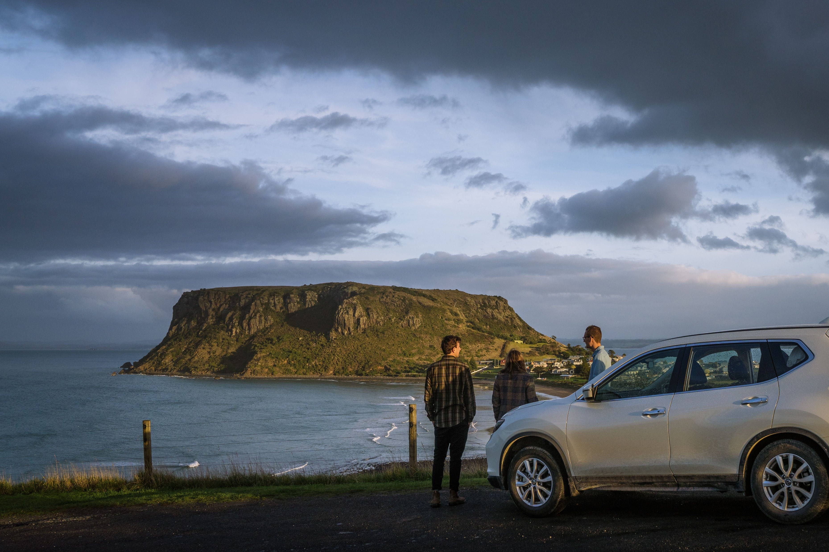


INTERSTATE VISITOR
PROFILE
YEAR ENDING DECEMBER 2025
The Nut, Stanley
Jason Charles Hill

Slide 2
Year ending December 2025
INTERSTATE VISITORS
Tasmanian Visitor Survey
Tourism Tasmania and Roy Morgan
 | SPEND | VISITORS | NIGHTS | ASPV | ASPN | ALOS
Interstate | $3.199b | 1.219m | 10.95m | $2,625 | $292 | 9.0
Change from 2024 | ▲ 11.4% | ▲ 7.8% | ► -0.4% | ▲ $86 | ▲ $18 | ► -0.3
Interstate holiday | $2.208b | 598.9k | 5.68m | $3,686 | $389 | 9.7
Change from 2024 | ▲ 14.6% | ▲ 8.4% | ▲ 7.5% | ▲ $198 | ▲ $24 | ► -0.1
INTERSTATE VISITORS
Around 88% of Tasmania’s visitors come from interstate, meaning their travel behaviours generally drive the overall trends for visitation, nights and spend.
Mainland visitors spent $3.199 billion in Tasmania, up 11.4% (+$328.6m) on 2024 ($2.871b) and $1.09b (+52%) more than in 2019 (not adjusted for inflation).
Tasmania welcomed a record 1.219 million interstate visitors, the highest ever for a 12‑month period, up 7.8% year‑on‑year.
Interstate travellers are spending more per visit (+$86) and per night (+$18), though their average stay shortened by around a third of a night.
With holiday visitors making up nearly half of interstate travel (49%), shifts in their behaviour strongly influence overall trends.
The interstate holiday market grew 8.4% to 598,900 visitors, up 20% on 2019. Each visitor spent more on average, while their length of stay held steady, leading to a higher spend per night.
All holiday key metrics rose year‑on‑year: spend +14.6%, visitation +8.4%, and nights +7.5%, underscoring Tasmania’s strong appeal in this core market.
Spend
Visitors
Nights
● All visitors  Holiday
● All visitors  Holiday
● All visitors  Holiday
ASPV
ASPN
ALOS
● All visitors  Holiday
● All visitors  Holiday
● All visitors  Holiday
VISITOR DATA SNAPSHOT
* ASPV – average spend per visitor. ASPN – average spend per night. ALOS – average length of stay (nights)

Slide 3
Interstate Visitors
Tasmanian Visitor Survey, YE December 2025
Tourism Tasmania and Roy Morgan
Spend share
Visitor share
Purpose of visit share by state of origin
 | HOLIDAY | VFR | BUSINESS /CONF. | OTHER | LEISURE HOL+VFR
VIC | 43% | 28% | 23% | 6% | 71%
NSW | 54% | 27% | 15% | 4% | 81%
QLD | 53% | 28% | 14% | 5% | 81%
SA | 53% | 24% | 20% | 4% | 77%
WA | 56% | 29% | 11% | 5% | 85%
ACT | 37% | 41% | 15% | 7% | 78%
NT^ | 49% | 42% | 7% | 2% | 91%
AUS | 49% | 28% | 18% | 5% | 77%
 | SPEND (m) | Change from 2024 | VISITORS (000) | Change from 2024 | NIGHTS (000) | Change from 2024 | ASPV | Change from 2024 | ASPN | Change from 2024 | ALOS (nights) | Change from 2024
VIC | $889.7 | 13.5% | 463.7 | 9.0% | 3,081 | 6.0% | $1,919 | $77 | $289 | $19 | 6.6 | -0.2
NSW | $932.1 | 8.0% | 325.7 | 3.9% | 3,027 | 1.3% | $2,862 | $108 | $308 | $19 | 9.3 | -0.2
QLD | $829.3 | 18.1% | 250.1 | 10.6% | 2,858 | 11.3% | $3,316 | $209 | $290 | $17 | 11.4 | 0.1
SA | $235.5 | 19.8% | 77.3 | 6.2% | 859 | 19.3% | $3,047 | $346 | $274 | $1 | 11.1 | 1.2
WA | $236.8 | -1.6% | 66.9 | 18.9% | 833 | -11.8% | $3,541 | -$737 | $284 | $30 | 12.5 | -4.3
ACT | $65.8 | 5.7% | 28.5 | -0.9% | 233 | -7.9% | $2,306 | $145 | $282 | $36 | 8.2 | -0.6
NT^ | $9.5 | -56.4% | 5.6 | -24.0% | 57 | -36.1% | $1,699 | -$1,258 | $168 | -$78 | 10.1 | -1.9
AUS | $3,199.5 | 11.4% | 1,218.6 | 7.8% | 10,952 | 4.6% | $2,625 | $86 | $292 | $18 | 9.0 | -0.3
VISITOR DATA SNAPSHOT
* ASPV – average spend per visitor. ASPN – average spend per night. ALOS – average length of stay (nights)
^ Changes in Northern Territory results are reflective of a reduced sample in 2025 compared to 2024

Slide 4
Interstate Visitors
Tasmanian Visitor Survey, YE December 2025
Roy Morgan
Age group
Travel party
Season of visit
● Interstate
● Interstate holiday
● Interstate
● Interstate holiday
Regional share of visitors and nights
● Visitors
● Nights*
Previously visited Tasmania
Intention to return
77%
Been before
92%
Intend to return
70%
Visit Hobart during their trip
71%
Of nights are spent outside Hobart
TASMANIAN TOURISM SNAPSHOT
*Regions share of nights will not round to 100% due to nights in unspecified places

Slide 5
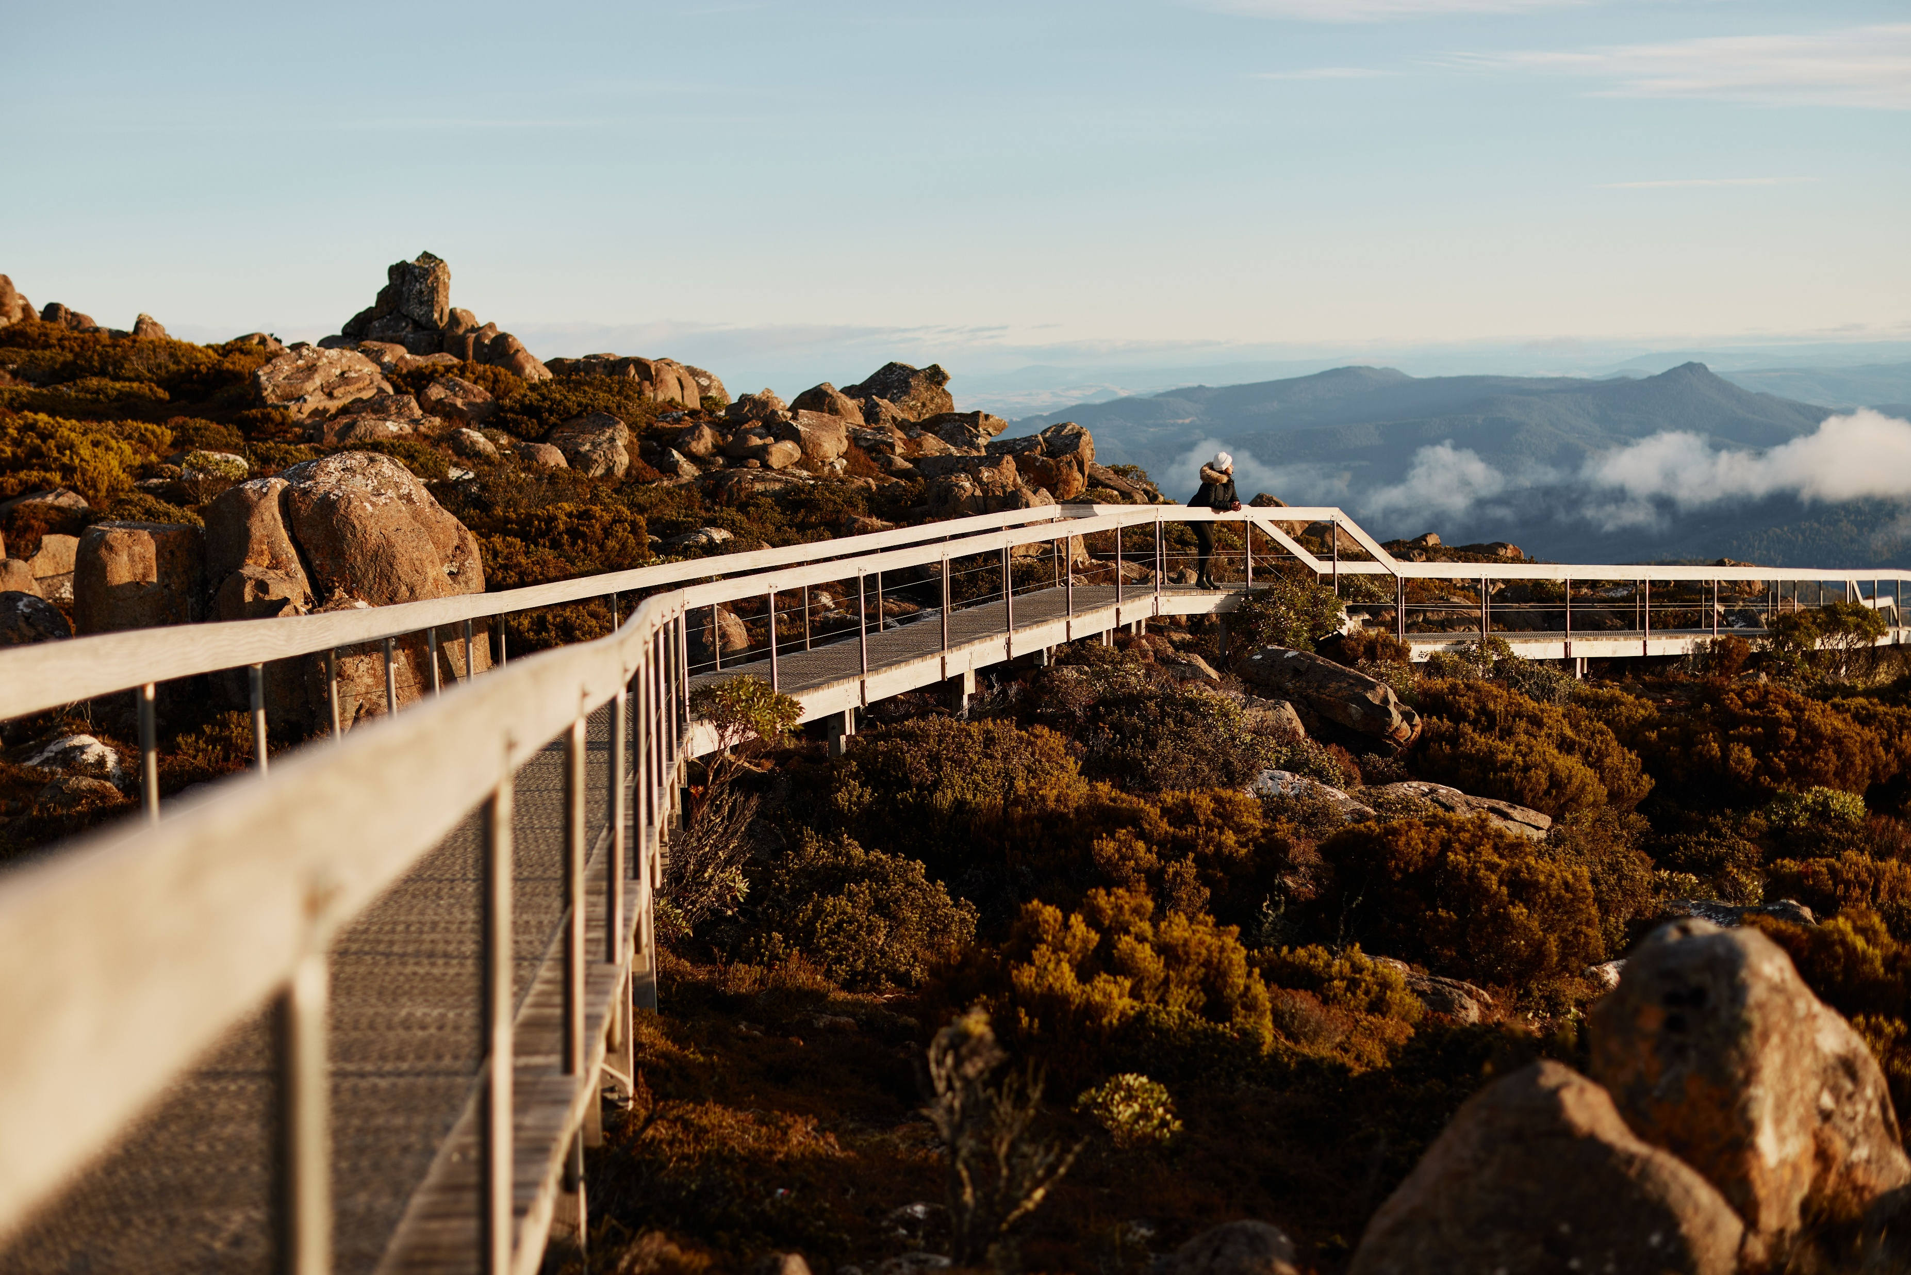

Visitors from Victoria
VICTORIA
Tasmanian Visitor Survey, YE December 2025
Tourism Tasmania and Roy Morgan
Visitors
● 2025
● 2024
Victoria is the largest market for visitors to Tasmania, and second largest for spend, amongst interstate visitors.
Total spend ($889.7m) was up 13.5% on the same period in 2024, with Victorians spending around $77 more each per trip.
Victorian spending has experienced continued growth over the year, reversing the downward trend seen from the peak of visitor spend in 2023 to mid-2024. This recovery is led by holiday and VFR visitors.
Victoria is traditionally Tasmania’s largest market but remains the only one of our top three markets (VIC, NSW, QLD) to have not yet fully recovered to 2019 levels of visitation, despite a 9.0% lift in visitation from last year, which was also the largest increase by volume of visitors of the top three markets.
The lag in recovery has been due to fewer visitors coming for most purposes of visit, except for VFR which has for the first time now surpassed 2019 levels.
Year-on-year there was growth in visitation for all purposes of visit, with particularly strong growth for VFR (+18.9%, to 137k).
Holiday visitation has increased 3.7% to 190k from the same period in YE December 2024.
Victorians stayed a total of 3.08 million nights in the state, up 6% on 2024, for an average of 6.6 nights, down only marginally on 2024 (-0.2 of a night).
Share of interstate visitation
Visitors
Spend
Nights
37%
27%
29%
Summit of Kunanyi / Mount Wellington
Samuel Shelley
VISITOR DATA SNAPSHOT

Slide 6
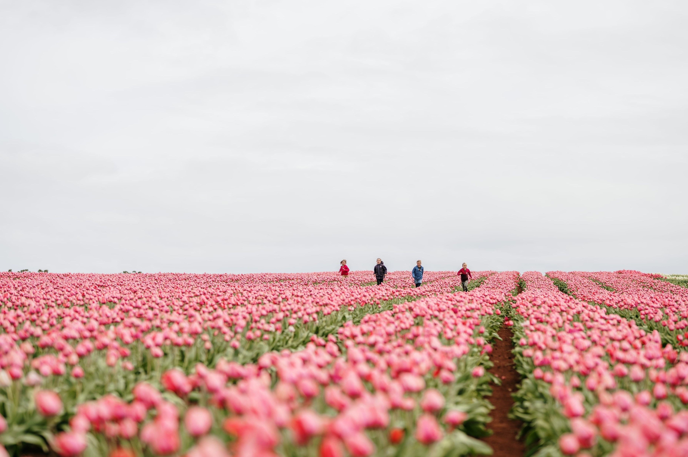

Visitors from New South Wales
NEW SOUTH WALES
Tasmanian Visitor Survey, YE December 2025
Tourism Tasmania and Roy Morgan
Visitors
● 2025
● 2024
New South Wales is the second largest market for visitors to Tasmania, though largest for spend, amongst interstate visitors.
Visitors from NSW spent $932m in YE December 2025, up 8.0% year-on-year, and up 44% on 2019.
Their average length of stay was down a marginal 0.2 of a night, however they also spent an extra $19 per night, leading to an overall increase in their spend per visit by $110, to $2,860.
Total visitation from NSW was 325.7k, up 3.9% year-on-year, and up 1.6% on 2019. Holiday visitation saw a surge from 2024, up 10.8%, and as the represent 56% of visitors this increase drove the overall increase from the state.
The increase in holiday visitation offset declines seen for VFR (-1.1%) and business or employment (-6.5%).
These visitors spent a total of 3.03 million nights in the state, 1.3% more than in 2024.
Share of interstate visitation
Visitors
Spend
Nights
27%
29%
27%
Table Cape Tulip Farm
Tourism Australia
VISITOR DATA SNAPSHOT

Slide 7
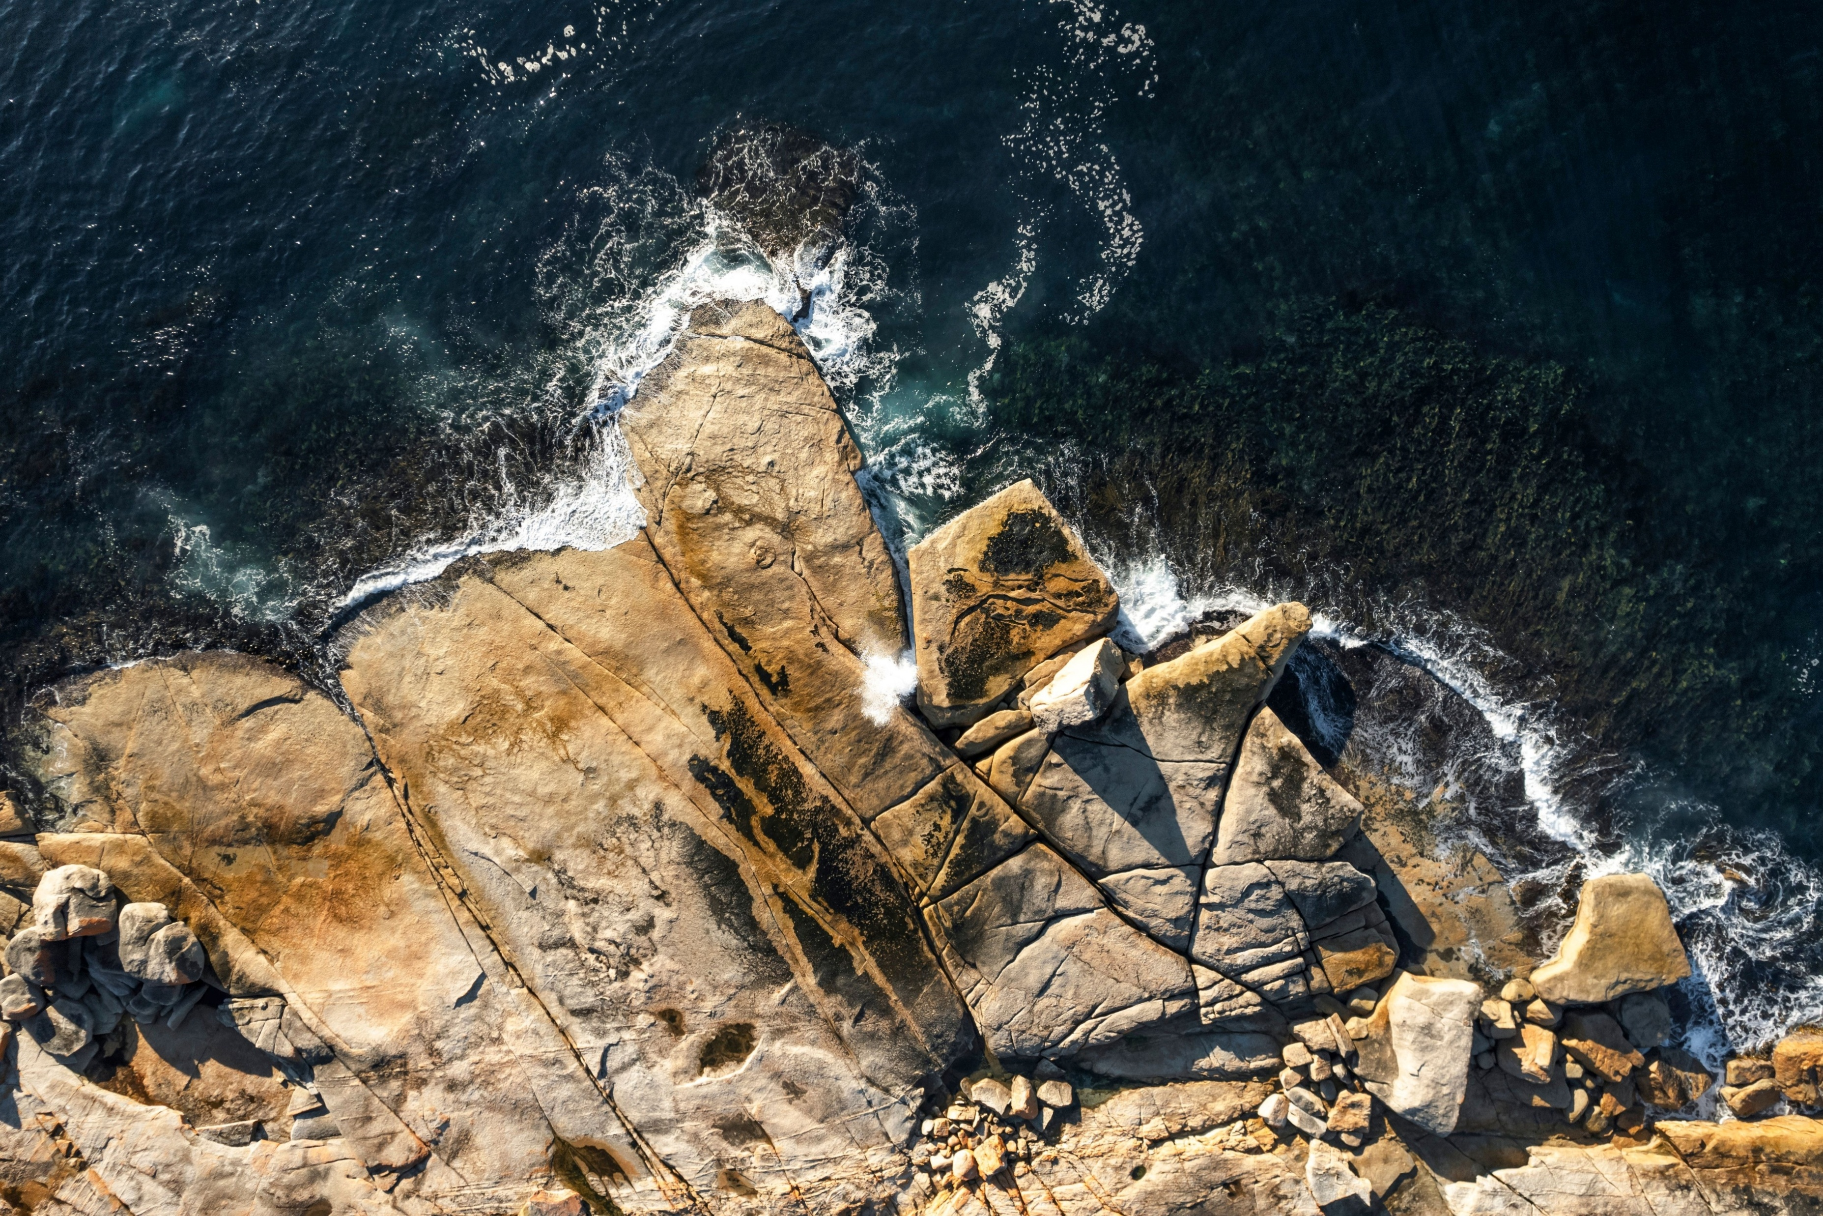

Visitors from Queensland
QUEENSLAND
Tasmanian Visitor Survey, YE December 2025
Tourism Tasmania and Roy Morgan
Visitors
● 2025
● 2024
Queensland is the third largest market for visitors to Tasmania and for spend, amongst interstate visitors.
Visitation surged 10.6% to a record 250,000 visitors in 2025. They spent more too, up 18.1% to $829m.
Queensland leads the top three states in growth since 2019, with an additional $408m in spend, 69k extra visitors, and 913k more nights stayed in 2025.
Queenslanders spent a total of 2.86m nights in the state, an 11.3% increase year-on-year, and a substantial 47% increase on 2019.
Average spend per visitor increased by $209 to $3,316 due to an extra $17 spent per night while the average length of stay did not change.
More Queenslanders travelled for a holiday (+13.8%) and for business/employment purposes (+18.9%) than the same period in 2024, together boosting overall visitation.
Explore more visitor data, including state of origin and purpose of visit, via the interactive TVS Analyser dashboard.
Share of interstate visitation
Visitors
Spend
Nights
20%
25%
25%
Bicheno Blowhole
Tourism Australia
VISITOR DATA SNAPSHOT

