Slide 1
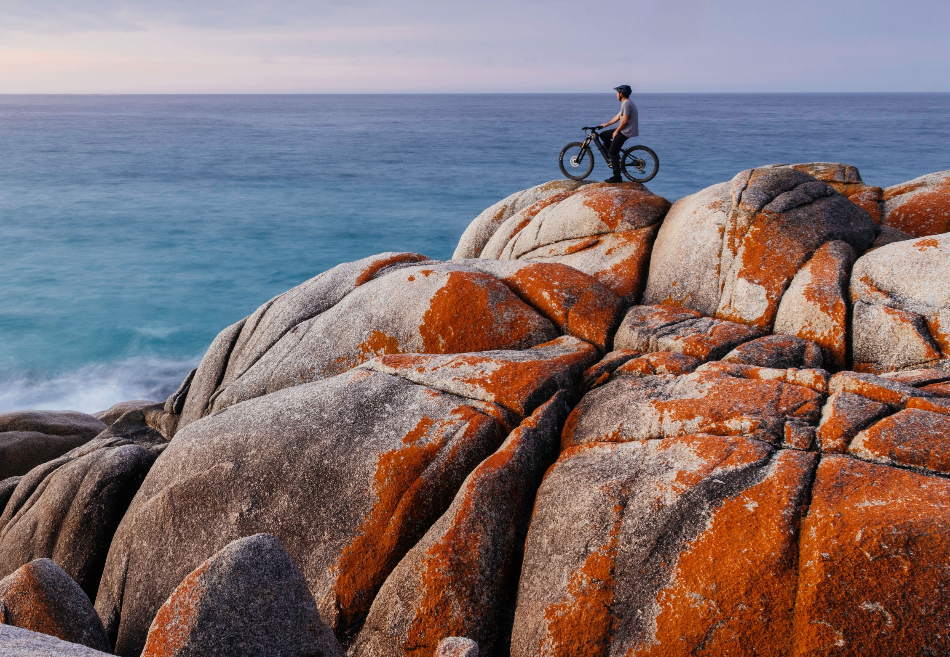


INTRASTATE VISITOR
PROFILE
YEAR ENDING DECEMBER 2025
Bay of Fires
Stu Gibson

Slide 2




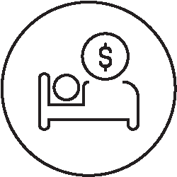

Intrastate trips by Tasmanians
INTRASTATE OVERNIGHT TRIPS – Year ending DECEMBER
Domestic Tourism Statistics (DoTS), Year ending December and December Quarter 2025
Tourism Research Australia
NOTE: Tourism Research Australia’s National Visitor Survey (NVS) has been superseded by Domestic Tourism Statistics (DoTS) from January 2025. Previously published NVS data cannot be compared with DoTS. More results will be published as the time series builds.
SPEND
$866.1m
▲ 2.5%
▲ 50.7%
TRIPS
1.858m
▼ -7.5%
▲ 14.6%
NIGHTS
5.23m
► -0.7%
▲ 26.6%
ASPT*
$466
▲ $45
▲ $112
ASPN*
$166
▲ $5
▲ $27
ALOT*
2.8
► 0.2
► 0.3
Change from
2024
2019
Intrastate visitation data on this page comes from Tourism Research Australia’s Domestic Tourism Statistics (DoTS).
OVERNIGHT TRIPS
Tasmanians spent $866.1m on overnight trips within the state in the year ending December 2025, up 2.5% on the same period last year, and up 50.7% on 2019.
In the December quarter 2025, Tasmanians took fewer overnight trips, as well as spent less per night with slightly shorter trips, leading to overall reduction in spend.
Regional data is only available from 2025, with no comparison available yet for previous years.
Definition of an overnight trip
Overnight trips must include at least one night away and be a minimum of 40 kilometres from the respondent's usual place of residence.
INTRASTATE OVERNIGHT TRIPS – December Quarter
SPEND
$224.9m
▼ -18.3%
TRIPS
466.6k
▼ -12.8%
NIGHTS
1.274m
▼ -2.2%
ASPT*
$482
▼ -$32
ASPN*
$177
▼ -$35
ALOT*
2.7
► -0.3
Change from
2024
HOLIDAY OVERNIGHT TRIPS⁺ – December Quarter
SPEND
$161.6
72%
TRIPS
267.2k
57%
NIGHTS
811.6k
64%
ASPT*
$605
ASPN*
$199
ALOT*
3.0
Share of total
Spend in regions
Overnight trips to regions
Nights in regions
● December Quarter 2025
● December Quarter 2025
● December Quarter 2025
VISITOR DATA SNAPSHOT
* ASPT – average spend per trip. ASPN – average spend per night. ALOT – average length of trip (nights)
+ Purpose and regional data from DoTS has not been back cast prior meaning data is only available from 2025 and is not comparable to previously published NVS results.

Slide 3
Intrastate trips by Tasmanians
INTRASTATE DAY TRIPS - Year ending DECEMBER
Domestic Tourism Statistics (DoTS), Year ending December and December Quarter 2025
Tourism Research Australia
Intrastate visitation data on this page comes from Tourism Research Australia’s Domestic Tourism Statistics (DoTS).
DAY TRIPS
Tasmanians spent $628.2m on day trips within the state in 2025, down 12.7% on 2024 though this is still up 53.4% on 2019. While they also took fewer day trips (4.54m, down 13.8%) this was however 17.1% more day trips than taken in 2019.
Tasmanians spent on average $138 per day trip in 2025, only $2 more per trip than the same period in 2024, though $33 more than in 2019.
Over half of day trips (56%) are for ‘holiday’ purposes and represent 64% of total day trip spend in the state.
Definition of a day trip for this data
A day trip is a trip that involves a round-trip distance of at least 50 kilometres from the respondent's usual place of residence, lasting a minimum of four hours and does not involve an overnight stay.
SPEND
$628.2m
▼ -12.7%
▲ 53.4%
TRIPS
4.54m
▼ -13.8%
▲ 17.1%
ASPT*
$138
▲ $2
▲ $33
Change from
2024
2019
INTRASTATE DAY TRIPS – December Quarter
SPEND
$173.9m
TRIPS
1.15m
ASPT*
$151
HOLIDAY DAY TRIPS – December Quarter
SPEND
$111.7m
TRIPS
640.5k
ASPT*
$174
Day trip spend by purpose
Day trips by purpose
VISITOR DATA SNAPSHOT

